Slide 1
The economic potential of
inter-generational solidarity
homesharing (ISH) in France
09.30.2022

Slide 2
agenda
Why did we decide to measure economic impact?
Quick presentation of the general methodology
The profiles of the young and elderly people in ISH
Summary of significant impacts
Impacts on the National Family Allowance Fund (Caisse nationale d’allocations familiales (CNAF) and the young people
Impacts on the elderly people

Slide 3
1
Why did we decide to measure economic impact?

Slide 4
The legal fraMework
ISH arises from the double observation of
The isolation of the elderly highlighted in the impacts of the 2003 heatwave
Recurrent problems of housing for young people
ISH is governed by law since 2018
(In short) several points are clarified in the law:
The objective is "to strengthen the social bond“
There is no “rent” but a “financial compensation” that qualifies as “modest”
Solidarity is a necessary aspect of the system, therefore the term "solidarity" is now attached to "intergenerational homeshare".
The "intergenerational" age range is specified: young people "under 30 years of age" and senior citizens "over 60 years of age"
Here is the complete legal framework
Law https://www.legifrance.gouv.fr/jorf/article_jo/JORFARTI000037639620
decree : https://www.legifrance.gouv.fr/loda/id/JORFTEXT000041400365/

Slide 5
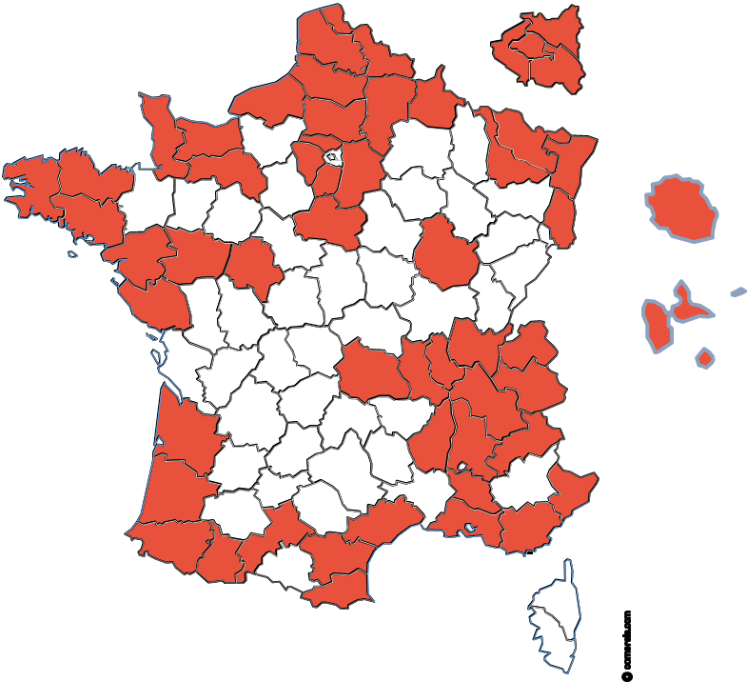
Who we are
Began in France in 2004
In order to coordinate the implementation of the ISH and support it, a first structure was created by Aude Messéan : Le Pari Solidaire
First activity in France
38 associations
937 new contracts signed between 1 January and 31 December 2021
Following numerous requests, the CoSI (become Cohabilis) Network was initiated in 2005 in order to federate the new wills and facilitate the cooperation between the emerging structures
The network works thanks to the support of its militant partners (public and private) and on a democratic basis: a member = a voice

Slide 6
Where we are
Promotes mutual support
100% proximity
100% digital
Digital platforms
Seeks to maximise the senior's income

Slide 7
Two standard formulas, one idea
« Solidary »
« Convivial »
Free for 18-30 years-olds and financial solidarity for the senior
Commitment of young people to be present several evenings per week and one weekend every two weeks
Occupancy fee significantly lower than local real estate costs
No commitment of young people to be present
In all cases, the young people and the senior are committed to create convivial bonds
The coordination structure ensures the creation and the smooth running of the homesharing
All the matches are always tailor-made
Notes:
50 % to 60% is public or private grant

Slide 8
Coordination organisation for homesharing
The members of the network co-ordinate the ISH between young people aged between 18 and 30 (students, trainees, etc.) and persons aged over 60
They set themselves the general objectives of
Facilitating the expression of solidarity, commitment and bringing generations closer
Expand the supply of housing and thereby develop youth mobility
Fight against the isolation of seniors, young people, and reassure their families
Preventing loss of autonomy of elderly
Optimize energy consumption through the use of rooms left vacant
Many members of Cohabilis Network offer diversified solutions in the field of housing, old age and youth
Notes:
disability

Slide 9
The hybrid revenue model of the ISH associations Coexistence of different income models. Here is the global average one
To cover the cost of the service, the members of the network have recourse to hybrid financing, and very varied situations. On average, this represents :
Beneficiaries' contributions represent 26%.
Public grant 55%.
Private aid 11%
For an overall cost of €1,510 per contract, this represents :
409€ from the beneficiaries (including membership, application and follow-up fees)
865 € of public grants or subsidies
173 € of private aid
63 € volunteering (e.g. voluntary work, provision of premises)
Important point: this is the "average" model. However, there is a wide variety of economic models in the network
Beneficiaries' contributions
Public grant
Private aid
volunteering
Other

Slide 10
motivations
The economic model of the structures is mixed private-public
The associations have been looking for funds every year… for 18 years
We were and still are convinced that
ISH can not be a very solvent market
the economic impact for youth, elderly people and society is huge
Demonstrating the economic impact of our member associations can encourage public authorities to put in place a sustainable and structured support for ISH

Slide 11
2
Quick presentation of the general methodology

Slide 12
General objectives of the study
To help organisations promoting intergenerational solidarity homesharing to structure and sustain their economic models
Clarify the economic impact of the scheme and model it
Support funders to invest in a structured way

Slide 13
those who have studied
3 university economist researchers
Ikpidi Badji, PhD in economics from the University of Paris X Nanterre (intergenerational transfer specialist)
Jérôme Hubert, PhD of Economic Sciences, graduated from the University of Lille (housing specialist)
Christine Le Clainche, PhD of Economic Sciences, professor and researcher at the University of Lille (health specialist)
One
Jérémy Brémaud (Scop Ellyx), graduate in economics and management sciences from the University of Grenoble
Funding :
Ministry of Housing (DHUP)
Supplementary public pension fund (AGIRC ARRCO)
Coordinate by cohabilis

Slide 14
Main Phases of the study
Phase 1
Identify and evaluate the economic impacts of intergenerational solidarity homesharing
Phase 2
Evaluate the potential supply and the potential demand
Phase 3
Describe precisely the current economic models and model them
Phase 4
Propose financing scenarios for intergenerational solidarity homesharing

Slide 15
3
The profiles of the young and elderly people in ISH

Slide 16
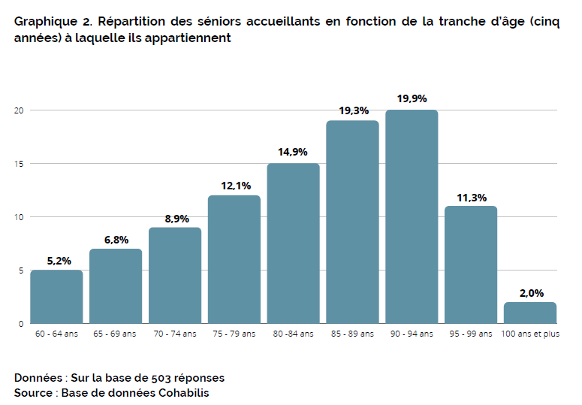
Profile of seniors
Nearly four out of five (79.1%) senior sharers are 75 years or older, with an average age of 83.5 years
A significant proportion of people over 85 years of age (52.5%), in line with the age of entry into an Establishment of Accommodation for Dependent Old Persons (86 years)
Moreover, from the age of 85, 61% of seniors receive help with daily living, regardless of their GIR.
Distribution of elderly householders by age group

Slide 17
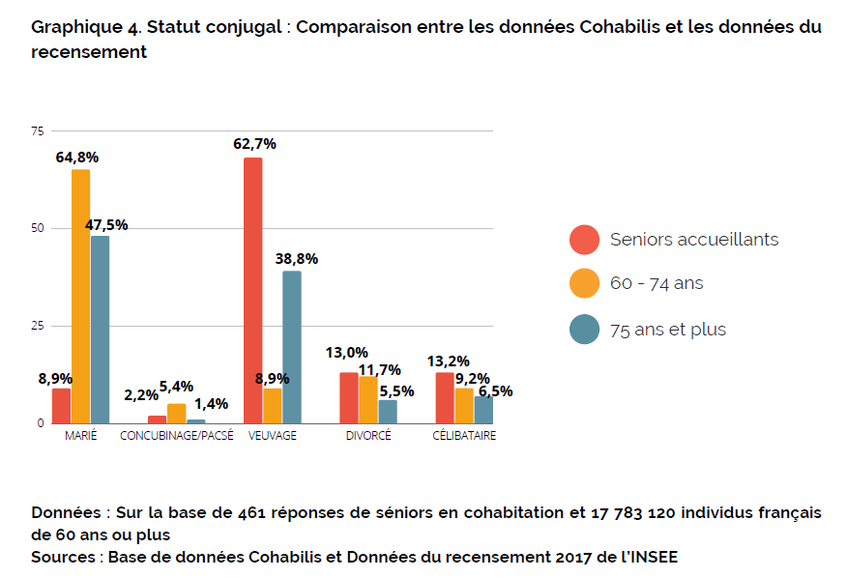
Profile of seniors
A proportion of 88.9% of elderly people who we can assume live alone
Lonely seniors :
single
divorced
Widowed
Other
Common Law
Married
Marital status : comparison between Cohabilis data and national data
Householders
Maried
Concubinage
Widowed
Divorced
Single

Slide 18
Profile of seniors
Senior householders occupy fewer houses than the rest of the population of the same age / compare to apartment
The proportion of housing of 100 m2 is significantly higher than for the rest of the population aged over 60 (39.7% for 60-74 year olds and 30.8% for 75 year olds and over)
It is interesting to note that the senior homesharers live very largely in housing with more than three rooms

Slide 19
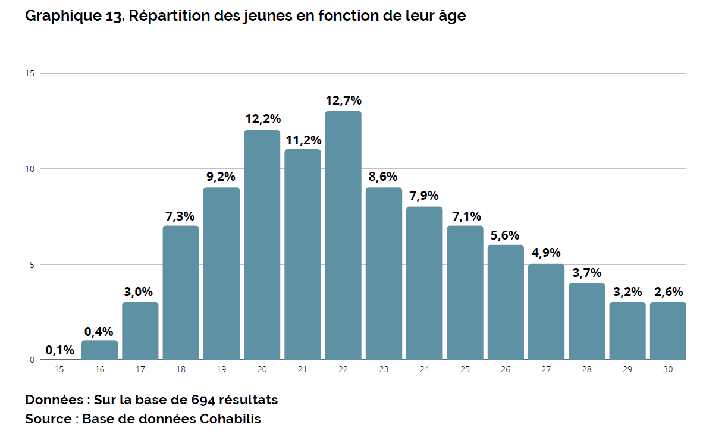
Profile of Young people
Just over three quarters (76.4%) of young people are in the 18-25 age group
Two-thirds of young people in homesharing (66.9%) are of French nationality, one in five comes from an African country (21.1%, including 9.0% from the Maghreb)
79,2 % of the young people hosted are students
Distribution of young homeharers by age group

Slide 20
4
Summary of significant impacts (parts 1 to 7 of the study)

Slide 21
Impacts on the National Family Allowance Fund (Caisse nationale d’allocations familiales (CNAF) and the young people

Slide 22
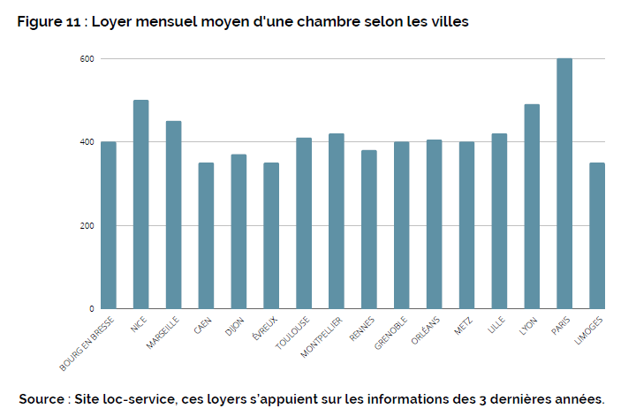
Average rents for a room in a private home
Average monthly rent of a room in a private home by city in France
(market price without solidarity)

Slide 23
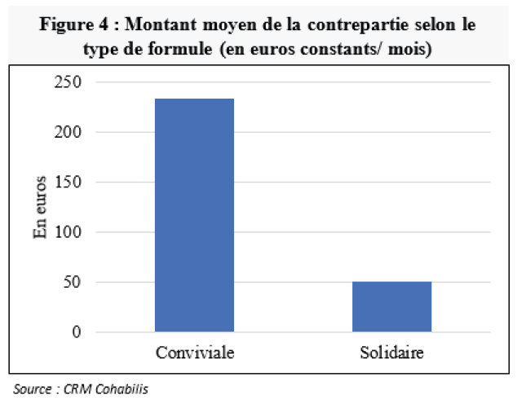
The modest financial compensation
Average amount of "modest financial compensation" in the context of intergenerational cohabitation implemented by our network

Slide 24
Estimated economic impact of Cohabilis in 2021
According to section 4.3.1 on the standard of living of young people, the average income of a young student aged 18-30 is 9906 euros per year.
On average, they spend 3807 euros/year on ordinary housing. Thus the disposable income after payment of rent is 6099 /year.
If this young person were in ISH
he would save 242/month (corresponding to the average rent savings of the different formulas and hypotheses)
his disposable income after payment of the rent would be 9003 euros/year, that is to say an increase of 48% in disposable income after payment of the rent.
Estimated overall impact of Cohabilis Network for 937 new contracts in 2021
1,700,655 (7.5 months x 242 x 937) overall savings for young people
576,255 (7.5 months x 82 x 937) in overall savings for the CNAF

Slide 25
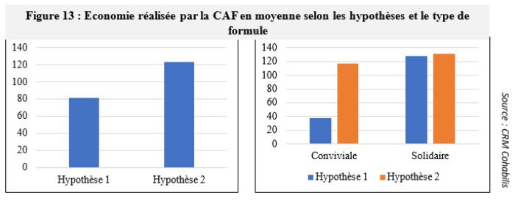
ESTIMATE OF THE SAVINGS MADE BY THE FAMILY BRANCH OF SOCIAL SECURITY : 2 hypothesis
Average savings for the CNAF according to the assumptions and the type of formula
To estimate the savings made by the CNAF, we make the difference between the allowances associated with market rent (APL_lpm) and the allowances associated with rent in ISH (APL_cfm)
Economy_CAF_Hyp1 = APL_lpm - APL_cfm
We distinguish a second hypothesis where young people in ISH do not receive any housing allowance (which is not the rule in France)
Economy_CAF_Hyp2 = APL_lpm
You can see that if the ISH does not give the right to housing allowance, in this case, the CNAF captures a portion of the improvement in the living standards of young people

Slide 26
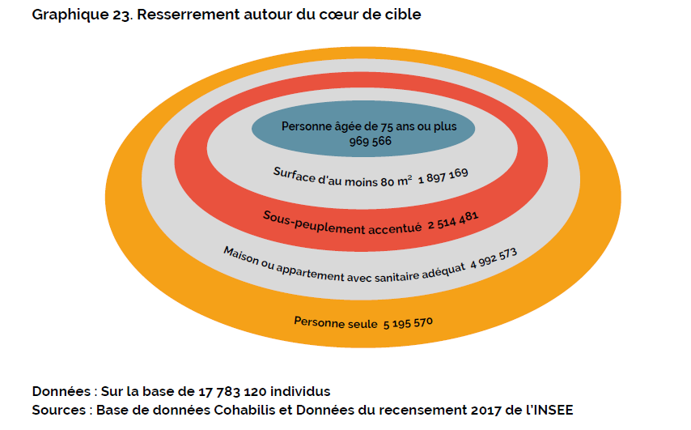
The potential number of ISH in France
Tightening around the core target

Slide 27
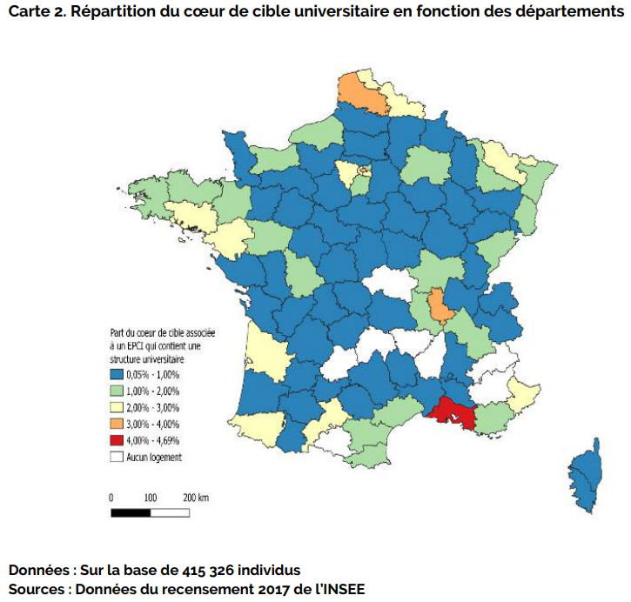
Geolocation by area concerned by a university structure and calculation of the maximum penetration rate
Distribution of the university target group by department
In order to propose a realistic analysis, we will use the most restrictive evaluation, i.e., the one that is located in areas with at least one university structure. This represents 415,326 rooms
To house students…
In 2012 the government launches the "40,000 plan
In 2017 the government launches the "60,000 plan
In 2019, only a quarter of scholarship students benefit from CROUS accommodation
We estimate that 100 094 housings are missing for students in France : 24,1% maximum « market » penetration rate

Slide 28
Difference between the overall economic impact and the cost of supporting the ISH
Penetration of potential supply | Number of CIS | Average saving/ CNAF allowance user-friendly formula | Average saving/ CNAF allowance Solidarity formula | Average savings made by young people in the convivial formula | Average savings made by young people in the solidarity formula | Estimated average overall savings (young people + CNAF) A | Average cost of support B | Difference between cost and savings (A-B)
0,50% | 2.077 | 591 840 € | 1 993 565 € | 3 504 313 € | 4 687 992 € | 5 388 855 € | 3 135 711 € | 2 253 144 €
5,00% | 20 766 | 5 918 396 € | 19 935 648 € | 35 043 131 € | 46 879 922 € | 53 888 549 € | 31 357 113 € | 22 531 436 €
10,00% | 41 533 | 11 836 791 € | 39 871 296 € | 70 086 263 € | 93 759 845 € | 107 777 097 € | 62 714 226 € | 45 062 871 €
14,40% | 59 807 | 17 044 979 € | 57 414 666 € | 100 924 218 € | 135 014 176 € | 155 199 020 € | 90 308 485 € | 64 890 534 €
24,10% | 100 094 | 28 526 666 € | 96 089 823 € | 168 907 893 € | 225 961 225 € | 259 742 804 € | 151 141 285 € | 108 601 519 €

Slide 29
Impact on the elderly people

Slide 30
Effects on older people associated with ISH in the scientific studies in the literature review (qualitative and quantitative studies)
The studies are not exclusively focused on intergenerational homesharing involving a young person and an adult but rather on a more collective homesharing integrating either people of the same generation or people of different generations
However, it can be estimated from these studies that the effect on mental health can be positively associated with inter-generational homesharing and that this effect is mediated by the social bond and the perception of mutual support made possible by this type of housing
In the studies reviewed, it appears that the social link provided by homesharing, whether intergenerational or intragenerational, is associated with a reduction in the feeling of loneliness and an increased perception of social usefulness and security
Among the scientific studies reporting a beneficial effect on social support, three types of support have been described:
instrumental (or functional) social support involving activities such as mutual borrowing of objects, housework, meal preparation, care in case of illness (and in the context of multiple homesharing, in case of need for childcare)
emotional support
support for leisure activities

Slide 31
Good overall health and a likely "Healthy older effect
In the 75+ age group, 76% of women report average, good or very good health (according to data from Care (2015))
The respondents in our sample are on average older and 89% of them answer that they are in good or average health
We can therefore assume that people who choose to live together self-selected by their health
we can thus mention the existence of a selection effect by the health of the elderly, i.e. a healthy older effect

Slide 32
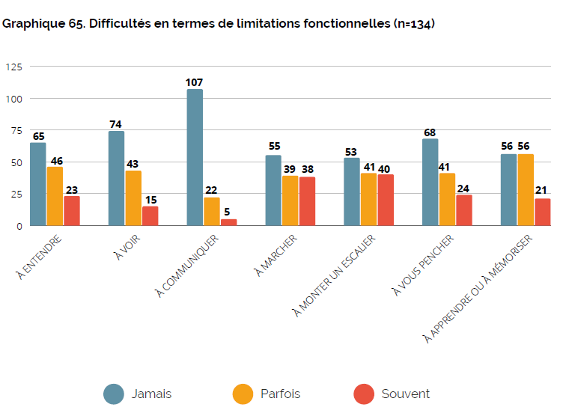
However, seniors acknowledge difficulties related to functional limitations: reduced mobility when walking, climbing stairs, bending, hearing, seeing, etc.
Difficulties in terms of functional limitations
To hear
To see
To walk
To communicate
To bend
To climb a staircase
To learn or memorize
Never
Sometimes
Often

Slide 33
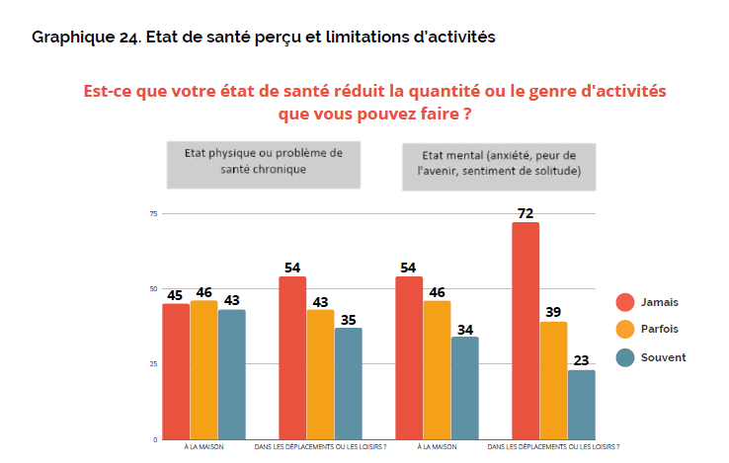
Associated functional limitations are often present
Perceived health status and activity limitation
Homesharing is unlikely to have much effect on physical health and the causality is likely to be the opposite
Activity limitations that need to be taken into account for the sustainability of participation in the programme, even if they are in better health than the comparable general population average.
Does your health condition reduce the amount or kind of activity you can do?
mental state (anxiety, fear of the future, feelings of loneliness)
Physical condition or chronic health problem
Never
Never
Sometimes
Often
At home
when travelling or at leisure
At home
when travelling or at leisure

Slide 34
The motivations of senior citizens
Regarding the choice to adopt homesharing, the two important responses mentioned are the desire to help and to overcome the feeling of loneliness.
Few responses (income), but an interesting fact that confirms the conclusion of another study we did: financial constraint is not a major trigger, and income level does not seem to be a relevant segmenting criterion
Reason for choosing to cohabit by income
Reasons for choosing to live together for seniors with an income of over 1800 euros
Reasons for choosing to live together for seniors with an income of below 1800 euros
Not taken into account
Not very important
Determinant
Not taken into account
Not very important
Determinant
Financial constraint
Desire to help each other
Loneliness
Financial constraint
Desire to help each other
Loneliness

Slide 35
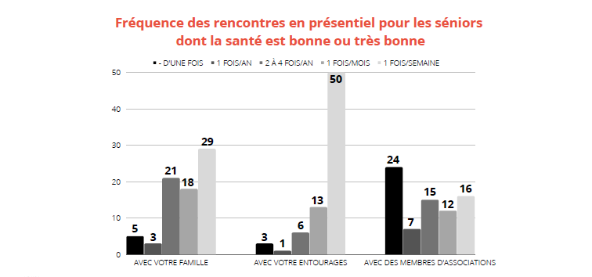
Social relationships are very important for elderly homesharers
112 seniors (out of 154) answered that they had at least one weekly telephone or video conference contact with a family member and 98 with a neighbour, friend, etc.
Frequency of face-to-face meetings for seniors in good or very good health (perception)
With family
With entourage
With association members

Slide 36
A proposition : Encourage academic study on inter-generational homesharing
Thank you !

